Slide 1
ARTIFICIAL INTELLIGENCE AS A STRATEGIC RESPONSE TO DIGITAL CURRENCY INSECURITIES
In one way or the other we have heard of digital currencies. The bitcoin, crpto among many others. However much digital currency is good it has struck thunder to governments considering that it has been linked with illegal activities such as funding terrorists among others.
Governments such as United States are against digital currency and have taken this case to court. Imagine how good it would have been if your relative from abroad could be able to send you money at anytime just like M-pesa. Just like anything any good thing can be abused, digital currency is abused. Therefore our project focuses on how this issue can be solved using Artificial Intelligence.

Slide 2
KEY TERMS
Bitcoin and crypto- this are types of digital currency.
Blockchain- A system in which a record of transaction made in bitcoin or another crypto currency is maintained across several computers that are lincked in a peer-to-peer network. This means that only a selected few who have the code can take part in this.
Mining- it is a network-wide competition to generate a solution that matches specific criteria. When a correct solutuion is reached, a reward in form of bitcoin and fees for the work done is given to the miners.

Slide 3
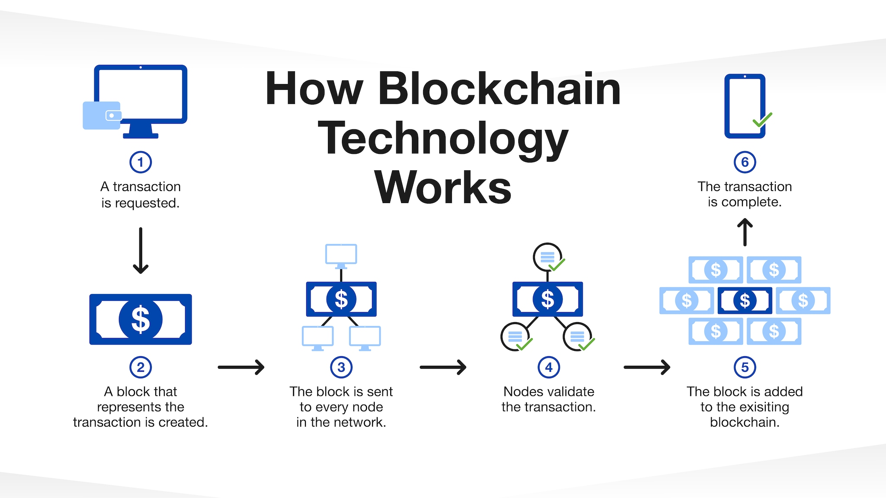

Slide 4
What has happened is no government has been able to track this transactions. This is why countries such as the United States have taken this case to court. The fact that the moment you are handed over the code to, you do not get to sign up anywhere!
What this means is instead of using identification cards, phone numbers and emails you get to use random algorithms. Hence why the gorvernment can not get hold of the individuals taking part.
However through our research we have been able to prove that AI has the features required to track this form of transaction.

Slide 5
AI can be used in Fraud Detection and Prevention
AI systems, especially those based on machine learning can distinguish between legitimate and suspicious behaviour with far greater speed and acuracy than human agents. You will be surprised to find out that paypal uses AI to identify suspicious activities.

Slide 6
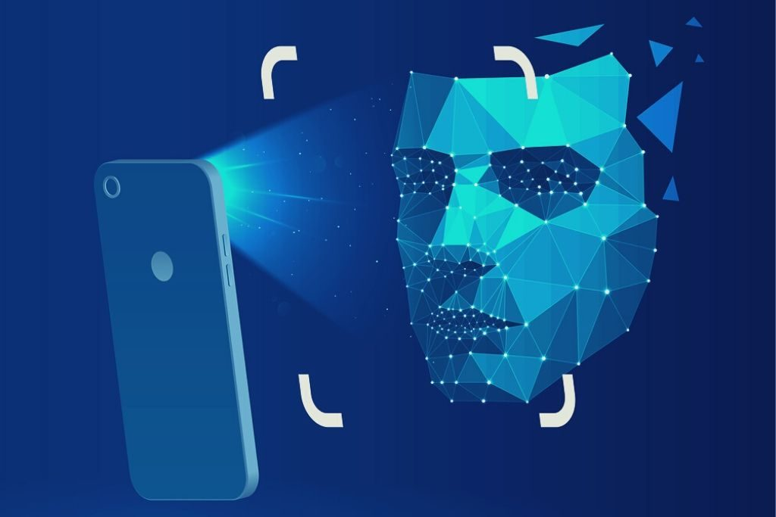
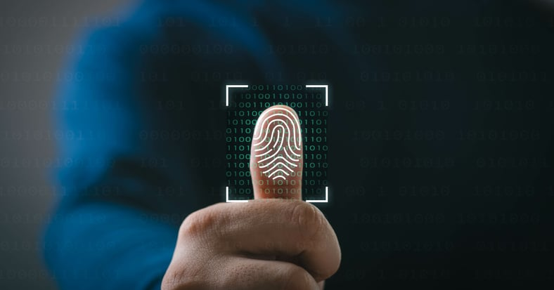
AI-ENABLED ANTI-MONEY (AML) and KNOW -YOUR-CUSTOMER (KYC) COMPLIANCE
Automated KYC processes include:
Facial recognion Document parsing Biometric authintification

