Slide 1
Dominic Ongwen was abducted in 1987 when he was 8 or 9 years old by the Lord’s Resistance Army (‘LRA’) in Northern Uganda and trafficked as a child soldier; he made multiple unsuccessful attempts to escape, and finally succeeded in late 2014. He turned himself into the International Criminal Court in 2015 and was prosecuted. Mr. Ongwen’s defence was that he was not responsible for the crimes of the LRA, based on his mental illnesses and duress, stemming from his abduction and subsequent coercion and indoctrination under Joseph Kony within the LRA. In February 2021, the ICC’s Trial Chamber IX convicted Dominic Ongwen of 61 charges and two modes of liability and he was sentenced to 25 years incarceration.

Slide 2
Ongwen case – A case of “firsts” and staggering numbers

Slide 3
The Ongwen case is still one of the most complex cases at the ICC, and presents a myriad of issues which are fundamental to international criminal law and whether international justice can attain legitimacy. The Defence in the Ongwen case challenged the default settings of the ICC in respect to its white supremacy, racism, culturalism and lack of access to justice for the disabled.

Slide 5
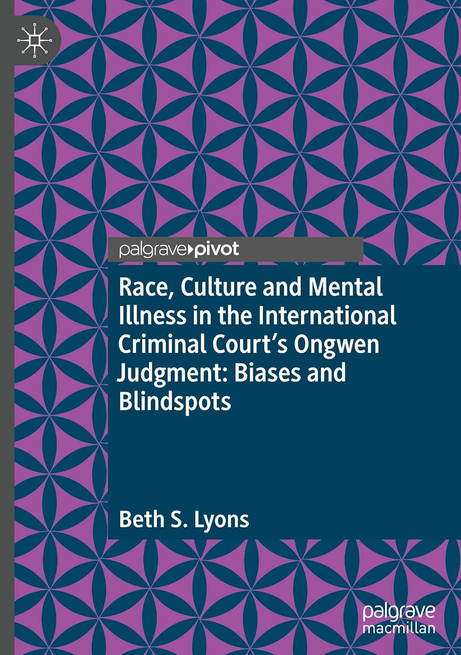
Race, Culture and Mental Illness in the International Criminal Court’s Ongwen Judgment: Biases and Blindspots: Biases and Blind Spots
About the book: Chapter 1 demonstrates how the Ongwen Trial Chamber’s biases and blindspots in respect to race and culture impacted its jurisprudence, resulting in its rejection of the mental illness and duress affirmative defences and any relevance of, and role for Acholi traditional justice in its sentencing.
Chapter 2 focuses on the Trial Chamber’s failure to reasonably accommodate Mr. Ongwen, a mentally disabled defendant and provide equal access to justice for him, resulting in a violation of his fair trial rights.
Chief Charles A. Taku, Lead Counsel in Ongwen, contributed the Introduction to the book.

Slide 7
Article 31 Grounds for excluding criminal responsibility
1. In addition to other grounds for excluding criminal responsibility provided for in this Statute, a person shall not be criminally responsible if, at the time of that person’s conduct:
(a) The person suffers from a mental disease or defect that destroys that person’s capacity to appreciate the unlawfulness or nature of his or her conduct, or capacity to control his or her conduct to conform to the requirements of law. . .
(d) The conduct which is alleged to constitute a crime within the jurisdiction of the Court has been caused by duress resulting from a threat of imminent death or of continuing or imminent serious bodily harm against that person or another person, and the person acts necessarily and reasonably to avoid this threat, provided that the person does not intend to cause a greater harm than the one sought to be avoided. Such a threat may either be:
(i) Made by other persons; or
(ii) Constituted by other circumstances beyond that person’s control.

Slide 8
Mr. Ongwen’s Diagnoses
Defence Experts: severe depressive illness, dissociative disorder (including dissociative identity disorder); PTSD; and severe suicidal ideation and is at a very high risk of committing suicide. Also depersonalization and derealization associated with dissociation, dissociative amnesia and symptoms of obsessive compulsive disorder
Court-Appointed Expert: Major Depressive Disorder (MDD); PTSD; and Other Specified Dissociative Disorder; labelled MDD and PTSD as severe.

Slide 9
Trial Chamber’s Methodology Critique

Slide 10
Methodology Critique Prongs
#1 Blurring the role of Defence Experts (whether treating or forensic psychiatrists)
#2 Failure to apply “scientifically validated methods and tools”
#3 Unexpected contradictions between observations and final conclusions
#4 Failed to use other resources or collateral information to corroborate conclusions
#5 Explanations for excluding malingering were not satisfactory
#6 Reports were general and not focused on relevant period of charges
The Judgment’s “methodology critique” communicates a (not so) veiled criticism that the Defence Experts are incompetent and unqualified and should not be regarded as experts….but this critique is also personal because it is nearly impossible to separate out the “person” from the “professional conduct.”
The race of the Defence Experts, both of whom are Black Ugandans, was never articulated as a factor by the Trial Chamber in reaching its conclusions. But, it becomes an issue in the Chamber’s choice and application of criteria for methodology. This is compounded by the Chamber’s failure to acknowledge even a possibility that its biases influenced its conclusion that the Defence Experts’ evidence is unreliable, based on its deficient methodology. The unarticulated biases of the Chamber make its position on reliability of the evidence even more suspect, given that the Chamber had accepted the expert status of both Defence Experts, as well as their reports, with no objection from the Prosecution.

Slide 11
Five Key Examples of Racial/Cultural Biases
1. Psychometric Tests and Malingering (#2 and #5)
2. The “Layperson Criterion” and Spirit Possession (#4)
3. The Ongwen Exception and the Role of Spiritualism
4. Child Soldier Expert and Language of Escape
5. Acholi traditional justice, complementarity and sentencing

Slide 13
Ongwen Exception

Slide 14
Def Child Soldier Expert
Article 26, Rome Statute
Exclusion of jurisdiction over persons under eighteen
The Court shall have no jurisdiction over any person who was under the age of 18 at the time of the alleged commission of a crime.

Slide 15
Preamble to the Rome Statute
The States Parties to this Statute,
Conscious that all peoples are united by common bonds, their cultures pieced together in a shared heritage and concerned that this delicate mosaic may be shattered at any time, . . .
Emphasizing that the International Criminal Court established under this Statute shall be complementary to national criminal jurisdictions. . .

Slide 16
Determination of Sentence
Article 78 (determination of sentence) and Rule 145 should be amended to include traditional justice mechanisms within its process
Rule 145 (determination of sentence) should be amended to include the
factors of race, culture, religion and disability as individual circumstances.

Slide 17
The ICC has to identify, assess and evaluate the extent of the
problem of racial and cultural biases in its judgments, starting from its
beginnings.
Article 84 (revision of conviction or sentence)
Article 21(3) (application and interpretation of law must be
consistent with internationally recognized human
rights. . .)
Construct an argument for revision, based on “interests of justice”
jurisdiction, that racial & cultural biases resulted in jurisprudence
which violated Article 21(3)

Slide 18
CONCLUSION:
Is it “just” biases and blindspots or is it legal racism and culturism?

